Slide 1
AirKitchen:
Week 13 Update
Team FoodXYZ
Mengdan Yuan, Wen Xin

Slide 2
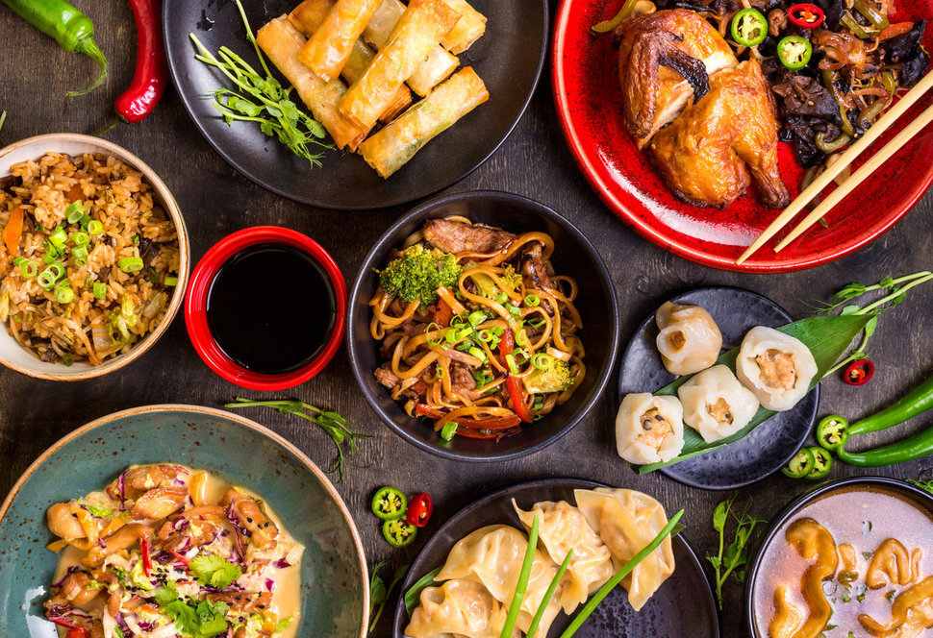
https://img.huffingtonpost.com/asset/585be1aa1600002400bdf2a6.jpeg?ops=scalefit_970_noupscale

Slide 3
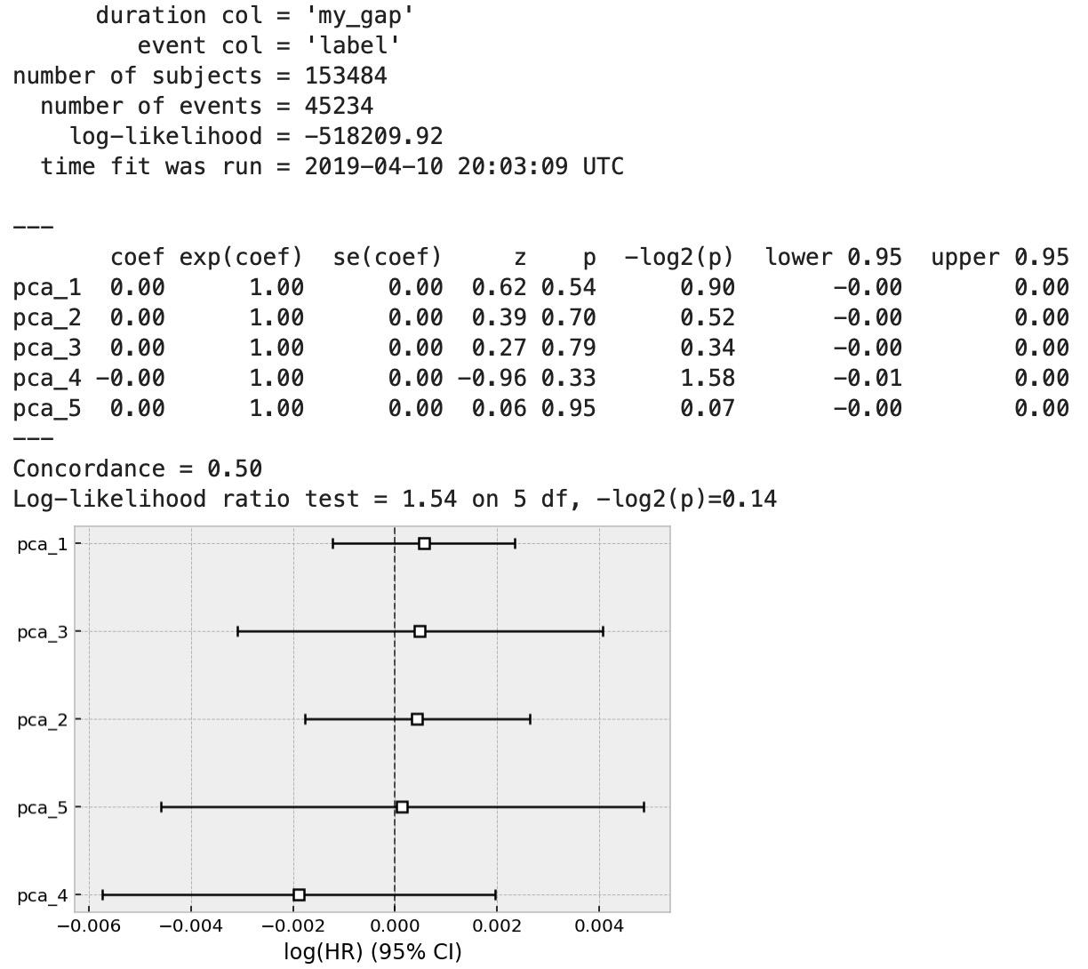
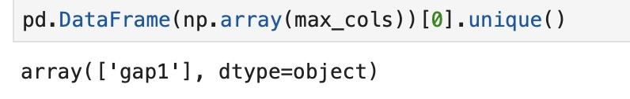
Survival Analysis
However, we meet bottleneck
in survival analysis...

Slide 4
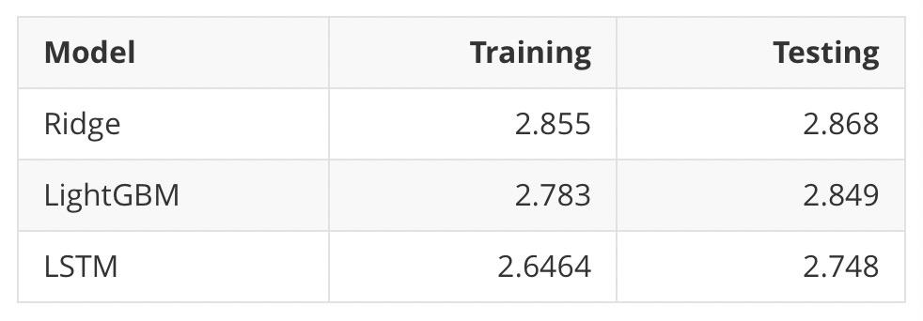
Regression
Evaluation: MAE

